Slide 1
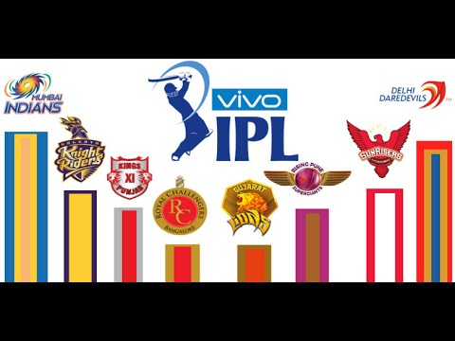
EDA of IPL Deliveries

Slide 2
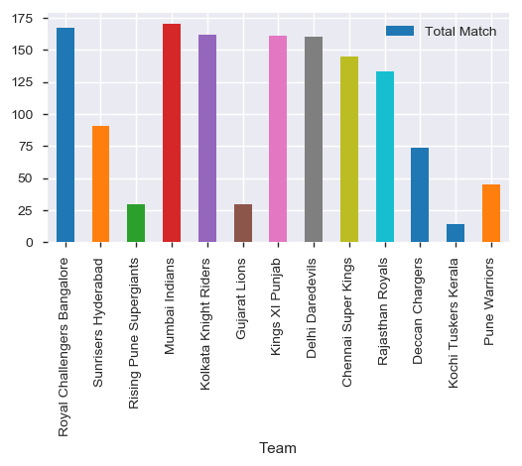
Which team has played how many matches ?
We can see that Rising Pune Supergiants , Gujurat Lions, Kochi Tuskar Kerala, Pune Warriors have less matches as compare to other teams as they came in later part of IPL seasons to replace few other banned teams.
Mumbai has played most matches.

Slide 3
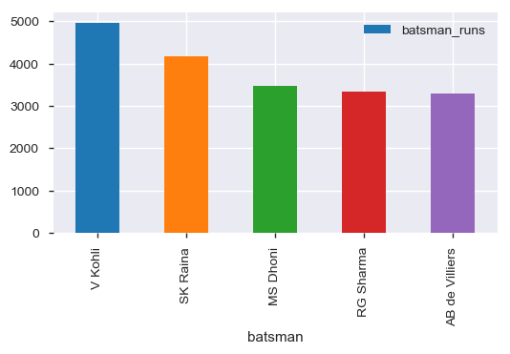
Who are the Top 5 batsman in IPL based on teams?
1. Virat Kohli has scored most runs among all batsmans.
2. There are 2 players each from RCB and CSK in top 5 batsman.

Slide 4
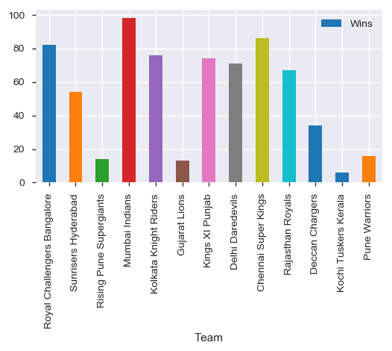
Most successful team in IPL?
We can see Mumbai Indians is the most sucessful team in IPL.

Slide 5
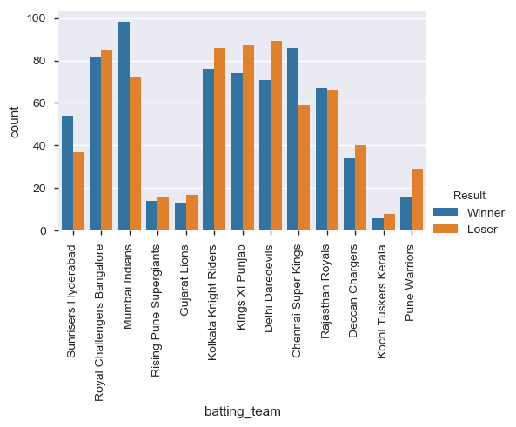
What is the win % of all the teams?
We can see Chennai Super Kings and Sunrisers Hyderabad have almost same win % but Chennai Super Kings have played more matches than Sunrisers Hyderabad.

Slide 6
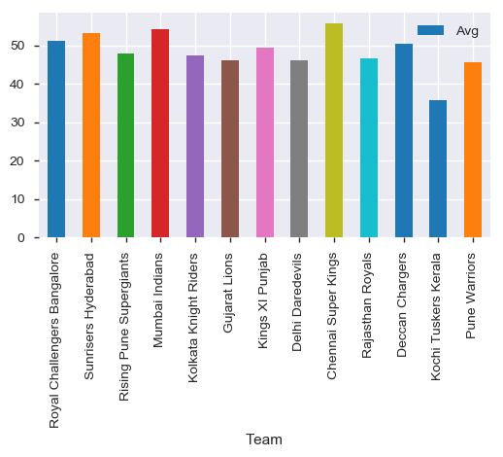
Who has maximum average last 5 over score?
We can see Mumbai Indians and Chennai Super Kings are on top having average of 54 and 55.

